Slide 1
Access Control List
(ACL)?
Dr. Muazzam A. Khan

Slide 2
Access Control Lists (ACLs)?
Learning Objective:
explain the differences between standard and extended ACLs
Explain the rules for placement of ACLs
Use ACLs to restrict virtual terminal access

Slide 3
Introduction
Access control list (ACL) consist of a table that tells a router/System (OS) which access rights each user has to a particular system object, such as a file directory or individual file.
Each object has a security attribute that identifies its access control list.

Slide 4
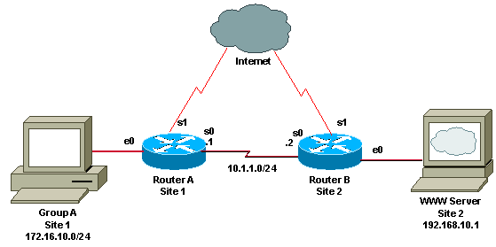
Cisco application view
ACLs are lists of conditions used to test network traffic that tries to travel across a router interface.
These lists tell the router what types of packets to accept or deny.
Acceptance and denial can be based on specified conditions.

Slide 5
ACLs benefits
Limit network traffic and increase network performance.
Provide traffic flow control.
Provide a basic level of security for network access.
Traffic decision ( forwarded or blocked at the router interfaces).
Permit or deny hosts to access a network segment.
can provide access control based on Layer 3 addresses for IP and IPX protocols.

Slide 6
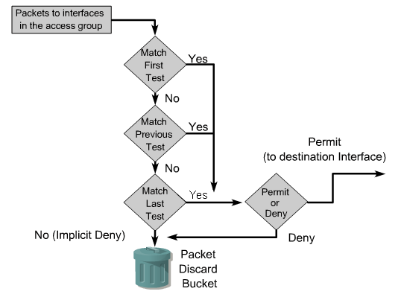
How ACL executed
Made decisions by matching a condition statement in an access list,
And then performing the accept or reject action defined in the statement.
ACL statements operate in sequential, logical order

Slide 7
Entering Frame to a Router
After indicate if the frame have a matched address or it’s a broadcast form, the router will check if there ACLs command present
If the packet is accepted or no ACL : the packet is encapsulated in the new Layer 2 protocol and forwarded out the interface to the next device.
ACL exists: the packet is tested against the statements in the list. If the packet matches a statement, it is either accepted or rejected.

Slide 8
ACL range for each protocols
ACLs can be created for all routed network protocols such as IP and Internetwork Packet Exchange (IPX)
ACLs can be configured at the router to control access to a network or subnet.

Slide 9
ACL range for each protocols
Each ACL must have a unique identification number.
This number identifies the type of access list created and must fall within the specific range of numbers that is valid for that type of list.
Ranges
  Standard ACL 1-99
  Extended ACL 100-199

Slide 10
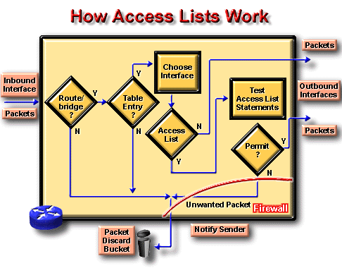

Slide 11
ACL configuration
Step 1:Router (config)# access-list access-list-number {permit/deny} {test condition}
Step 2:Router (config)# {protocol} access-group access-list-number
An ACL containing numbered ACL statements cannot be altered. It must be deleted by using the no access-list list-number command and then recreated.

Slide 12
ACL configuration –
Permit ACL line with L3 information only
If a packet's L3 information matches the L3 information in the ACL line , the packet's is permitted.
If a packet's L3 information does not match the L3 information in the ACL line, the next ACL entry is processed.
→If a packet's FO > 0, the packet is permitted.
Else , the next ACL entry is processed.

Slide 13
ACL configuration - Example
Router (config)# access-list 6 deny 172.13.0.0 0.0.255.255
Router (config)# access-list 6 permit 172.0.0.0 0.255.255.255
Router (config)# interface e0
Router (config-if)# ip access-group 6 in
If we want to delete or modify the ACL:
Router (config)# no access-list 6

Slide 14
Wildcard Mask
Wildcard Masking for IP address bits uses the number 1 and the number 0 to identify how to treat the corresponding IP address bits.
      A wildcard mask bit 0 means “check the corresponding bit value.”
      A wildcard mask bit 1 means “do not check (ignore) that corresponding bit value.”

Slide 15
Wildcard Mask
Wildcard masking for access lists operates differently from an IP subnet mask.
A zero in a bit position of the access list mask indicates that the corresponding bit in the address must be checked;
A one in a bit position of the access list mask indicates the corresponding bit in the address is not “interesting” and can be ignored.

Slide 16
Wildcard Mask
An administrator wants to test an IP address for sub-nets that will be permitted or denied.
Assume the IP address is Class B (first two octets are the network number) with eight bits of sub-netting (the third octet is for sub-nets).
The administrator wants to use IP wildcard masking bits to match sub-nets 172.30.16.0.
Notes:
Slides 15- The wildcard mask will check the first two octets (172.16) using corresponding zero bits in the wildcard mask.
Because there is no interest in individual host addresses (a host ID will not be .00 at the end of the address), the wildcard mask will ignore the final octet using corresponding one bits in the wildcard mask.
---------------------------------------------------------------------------------

Slide 17
Wildcard Mask
By carefully setting wildcard masks,
  an administrator can select single or
  several IP addresses for permit or deny tests.
  Refer to the example in the graphic →

Slide 18
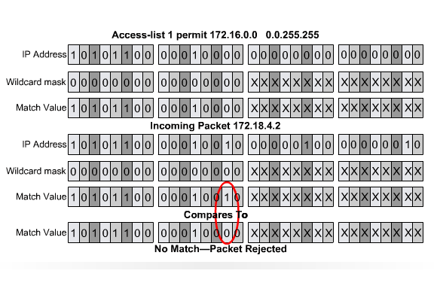
Wildcard Mask Application
Notes:
Slide 17- In the third octet,
where the subnet address occurs,
the wildcard mask will check that the bit position for the binary 16 is on
and all the higher bits are off
using corresponding zero bits in the wildcard mask.
The wildcard mask will ignore the value in these positions,
The address value can be binary 0 or binary 1.
In this way, the wildcard mask matches subnet 16, 17, 18, and so on up to subnet 31.
The wildcard mask will not match any other subnets.

Slide 19
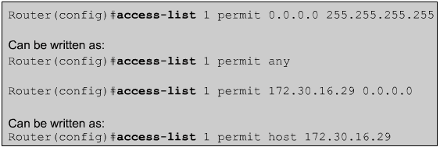
Any, Host, Optional Format
The any option substitutes 0.0.0.0 for the IP address and 255.255.255.255 for the wildcard mask. This option will match any address that it is compared against.
Notes:
Slide 18 - There are two special keywords that are used in ACLs, the any and host options.

Slide 20
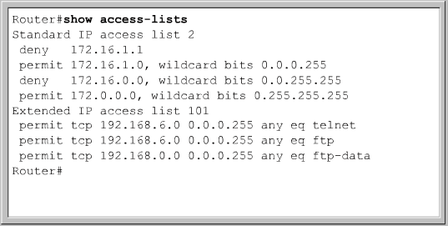
Verifying the ACL configuration
Show access-lists command:
display the access-lists configuration

Slide 21
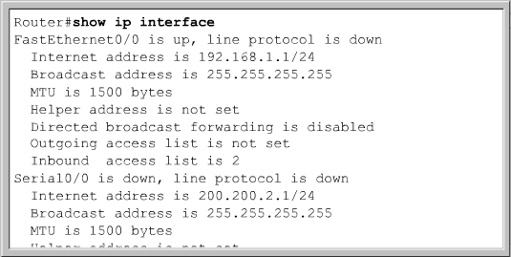
Verifying the ACL configuration
Show ip interface command:
display the access-lists interface assignments

Slide 22
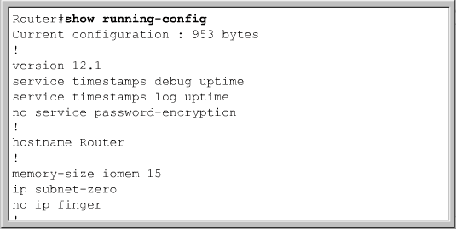
Verifying the ACL configuration
Show running-config command:
display the configuration output, including access-lists and assignments

Slide 23
Standard ACLs
A standard ACL can permit or deny trafiic based only on the source address(s).
checks the source address of IP packets that are routed.
The ACL will either permit or deny access for an entire protocol suite, based on the network, subnet, and host addresses.
the standard ACL command is as follows:
Router(config)#access-list access-list-number deny / permit / remarksource [source-wildcard ] [log]
Notes:
Slide 22 - For example, packets that come in Fa0/0 are checked for their source addresses and protocols. If they are permitted, the packets are routed through the router to an output interface. If they are not permitted, they are dropped at the incoming interface.

Slide 24
Standard ACLs, the remark keyword
The following entry is not right away clear it’s objective:
Router(config)#access-list 1 permit 171.69.2.88
→It is much easier to read a remark about the entry to understand its effect, as follows:
Router(config)#access-list 1 remark Permit only Jones workstation through access-list 1 permit 171.69.2.88
Notes:
Each remark is limited to 100 characters.

Slide 25
Standard ACLs
To remove a standard ACL use no statement. The syntax is as follows:
→Router(config)#no access-list access-list-number
The ip access-group command links an existing standard ACL to an interface:
→Router(config-if)#ip access-group {access-list-number | access-list-name } {in | out }

Slide 26
Extended ACLs
Extended ACL can permit or deny traffic based on both the source and destination address(s) as well as tcp/udp/icmp trafic types.
Access can be permitted or denied based on where a packet originates, its destination, protocol type, and port addresses.
When packets are discarded, some protocols send an echo packet to the sender, stating that the destination was unreachable.
Notes:
Slide 24 - An extended ACL can simultaneously allow e-mail traffic from Fa0/0 to specific S0/0 destinations and deny file transfers and Web browsing.

Slide 27

Extended ACLs - Statements
Access list number range of 100 – 199 and 2000 – 2699
Source destination IP address
Layer 4 protocol number
Applied to port closest to source host

Slide 28
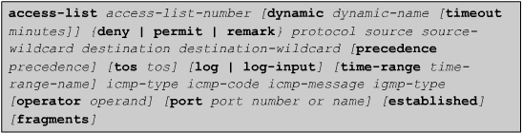
Extended ACLs - Parameter
Dynamic: Identifies the access-list as a dynamic access list
Timeout: specifies the absolute length of time
Protocol: name or number (0 – 255) of an Internet protocol
Source: Number of the network or host which it being send from (32 bit quantity in four part – any – host)
Destination: Number of the network or host to which the packet is being sent(32 bit quantity in four part – any – host)

Slide 29
Extended ACLs - Parameter
Source – Wildcard: Wildcard bits to be applied to source (32 bit quantity in four part – any – host)
Destination – Wildcard: Wildcard bits to be applied to destination (32 bit quantity in four part – any – host)
Other parameters included in the Extended ACLs:
Procedure, tos (type of service), log (keep history), log – input, time range, icmp – type…

Slide 30
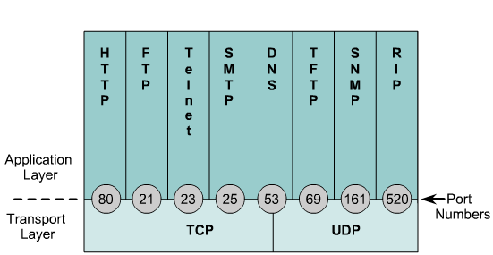
Transport – Application layer Ports

Slide 31
Named ACL
Access control lists (ACLs) perform packet filtering to control the movement of packets through a network.
The IP Named Access Control Lists feature gives network administrators the option of using names to identify their access lists.
Named access lists support the following features that are not supported by numbered access lists:
IP options filtering
Noncontiguous ports
TCP flag filtering
Deleting of entries with the no permit or no deny command

Slide 32
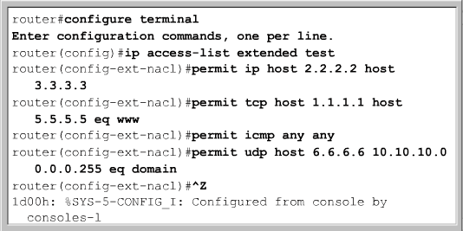

Named Access list
Modifying a Named Access list: any additions will be made to the end of the ACL
Creating Named Access list

Slide 33
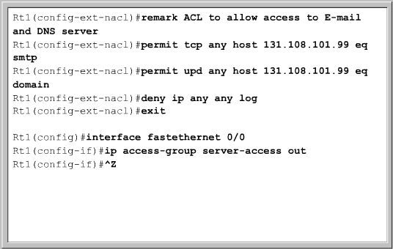
Advantages that are provided by a named access list
Alphanumeric names can be used to identify ACLs.
The IOS does not limit the number of named ACLs that can be configured.
Named ACLs provide the ability to modify ACLs without deletion and reconfiguration.
Notes:
Slide 32- However, a named access list will only allow for statements to be inserted at the end of a list. It is a good idea to use a text editor to create named ACLs.

Slide 34
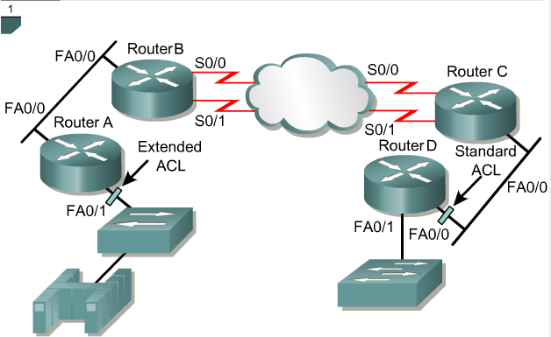
Placing ACLs
Extended ACLs as close as possible to the source of the traffic denied.
Standard ACLs do not specify destination addresses, so they should be placed as close to the destination as possible.

Slide 35
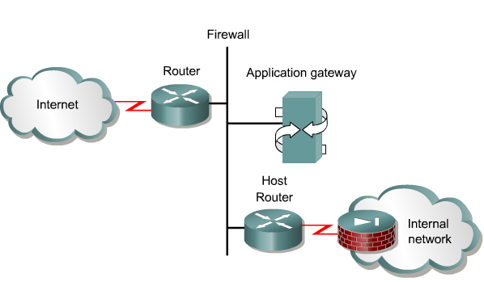
Firewall
It is an architectural structure that exists between the user and the outside world to protect the internal network from intruders.
ACLs should be used in firewall routers, which are often positioned between the internal network and an external network, such as the Internet.
The firewall router provides a point of isolation so that the rest of the internal network structure is not affected.
Notes:
Slide 33 - In this architecture, the router that is connected to the Internet, referred to as the exterior router, forces all incoming traffic to go to the application gateway. The router that is connected to the internal network, the interior router, accepts packets only from the application gateway. The gateway controls the delivery of network-based services both into and from the internal network.
ACLs should be used in firewall routers, which are often positioned between the internal network and an external network, such as the Internet. This allows control of traffic entering or exiting a specific part of the internal network. The firewall router provides a point of isolation so that the rest of the internal network structure is not affected.

